Slide 1


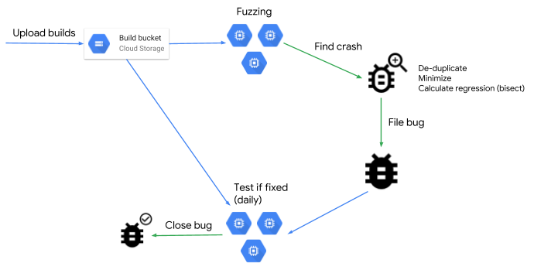

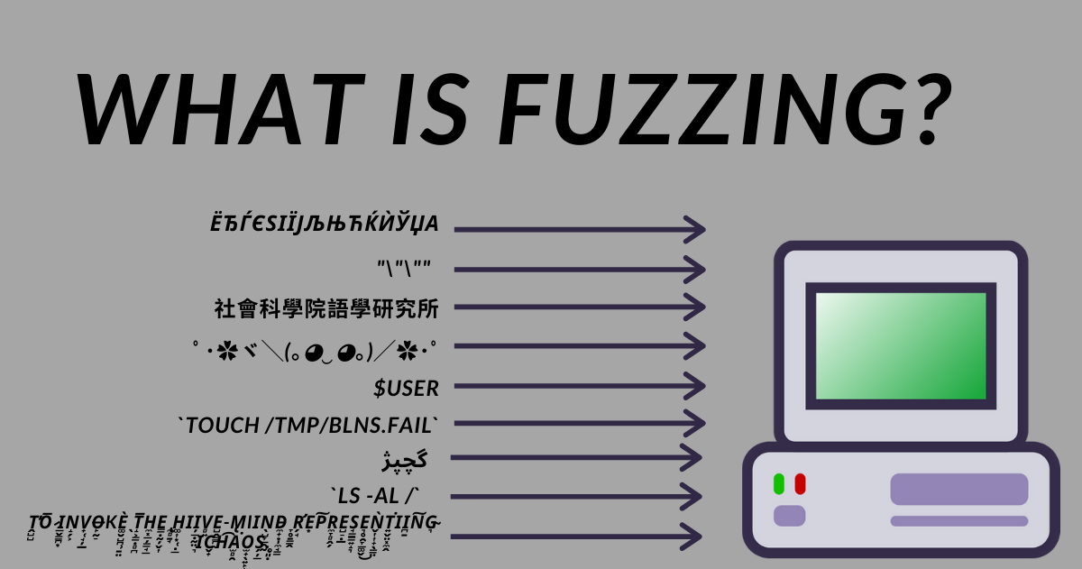
Fuzz Testing:
Detecting Unknown Vulnerabilities in a Program
Josh Urbach
Abstract
Modern Fuzzing
Protecting Against the Unknown
Conclusion
When writing software there are known and unknown vulnerabilities in all programs. We have already developed protection against known vulnerabilities, so it is the unknowns that are dangerous. Fuzzing is a technique that allows us to find many of those unknown bugs before potential attackers can find and exploit them. This research will explore fuzz testing and its security benefits.
As previously mentioned, fuzzing has evolved from its original blackbox and grammar-based techniques in earlier generations. Blackbox fuzzing suffered from being ineffective against applications that discard inputs that are in unusual formats, or inputs that lead to nothing. Grammar-based suffered from not being random enough. It improved on blackbox fuzzing by ensured the inputs were close enough to being valid that they were not discarded, and this method was very labor intensive while fuzzing is generally meant to help automate things.
That brings us to one of the modern-day forms of fuzzing, whitebox fuzzing. This type of fuzzing learns and adapts to previous input attempts trying to find bugs. The program understands what works and what does not as it continues to generate inputs to test many paths in the program. Microsoft describes whitebox fuzzing like this, “This approach consists of symbolically executing the program under test dynamically and gathering constraints on inputs from conditional branches encountered along the execution”. They go on to mention that since whitebox is more precise than blackbox and takes advantage of modern-day computational power, it can run through more code effectively and find more bugs than older methods. This is a common way of thinking and why whitebox fuzzing seems to be the a very popular type of fuzz testing in the modern day.
One important note about whitebox fuzzing is that it assumes the user has knowledge of the applications methods and can provide effective inputs by knowing this, but there is another modern form of fuzzing called greybox fuzzing that mixes pieces of blackbox and whitebox, hence the name. The testers do not need any knowledge of program, and instead observe behavior of each run to optimize the inputs needed to find a bug.
The last type of modern fuzzing that needs mentioning is Neural Fuzzing, which relies on machine learning and neural networks. This method is like grammar-based fuzzing but takes less human input by utilizing the advances in machine learning, so the inputs are very precisely directed for optimal results in bug searching. This is the newest type of fuzzing mentioned and appears to have a lot of potential moving forward.
Great techniques like this are always evolving so one could expect an even stronger type of fuzzing to be in the works right now.
You may be wondering what a developer can do with these unknown vulnerabilities that can be found while fuzz testing, and this is really the part provides some reasoning on why fuzz testing matters.
If you are fuzz testing your program correctly, there will not be any zero-day attacks because fixes will already have been developed during the fuzzing phase of design to prevent this. The attackers will either find no bugs or find one that has already been patched so there is no rushing around to implement a patch once the attack has begun.
The developer can eliminate unwanted output that would be generated from unusual user input prior to the program going live. Fuzzing provides so many inputs, that it will likely allow the developer to tailor the program to only accept inputs that will provide the desired output avoiding random crashes and strange outputs.
This is a low-cost way of finding potentially deadly bugs, and with modern fuzzing it has also become mostly automated, so it is a key piece in all application design.
Fuzz testing has been around for a long time and will continue to be a crucial piece of software testing to avoid security risks into the future as they continue to improve upon the technique. There are many types of fuzzing, and they are recapped below:
Blackbox: The original fuzzing, where many types of random inputs are generated to try and crash the program.
Grammar-Based: Template is used to provide some bounds to be explored using inputs in a format that is close to valid but violated some boundaries.
Whitebox: This methods tester needs to have a base understanding of the source code, and inputs precise values to find bugs learning from previous entries
Greybox: A mix of blackbox and whitebox fuzzing, the testing does not need to have any knowledge of the program but specifically looks at the behavior of past inputs to optimize future inputs to find a bug.
Neural or AI-Based: Capitalizes on machine learning to take the grammar-based approach with less human involvement by learning from past attempts.
Fuzz testing has some major advantages and can be seen here:
It can find many bugs in a short amount of time, that would not likely be found without the method as highlighted by Google’s ClusterFuzz finding 16,000+ bugs in chrome alone over a few years.
Modern day fuzzing is becoming automated, so one of the original cons of taking a lot of manual labor is being alleviated.
Using fuzzing in the early security design process can avoid the ability for attackers to use it later and having to rush to patch the software during a zero-day attack.
It finds defects overlooking during software development and reveals unexpected output that could occur. This allows developers to easily update the entry validation so the program will only accept the types of inputs they are looking for allowing it to provide outputs that are desired as well
Overall, fuzzing should be implemented by anyone who is planning to release a program to the public. Even if they are not concerned by the security benefits it provides for some reason, it also can help increase efficiency within the program. This can alleviate some of the tedious use case testing that would be done on a program and can help find all kinds of little bugs that may make the program less efficient. Fuzzing has a place in the design process of all programs.
Introduction
To put it simply, fuzzing is a way to find unknown bugs in an automated fashion by tossing all kinds of data inputs into the computer to cause unexpected behaviors to occur. A fuzzer will take a bunch of invalid inputs and input them into a program so they can monitor its behavior and evaluate if any vulnerabilities are detected. This is a key tool in finding unknown bugs in programs, which tend to be the most dangerous kind because there may not be security designed to protect against it. Another important factor to note is that bad actors will use fuzzing to find these vulnerabilities and exploit them before a company can, so it is important to find them first.
To provide a brief history of where fuzz testing came from, you can start by looking at Professor Barton Miller who originally developed it at the University of Wisconsin in 1989. Miller and his students noticed that many applications would crash when you gave them unusual inputs, and that is what led to further development in this technique. Dr. David Brumly, a Carnegie Mellon University professor, summarized the original fuzzing as “monkeys typing on a keyboard” because of the random nature of the inputs provided to find issues.
In this first generation they used blackbox fuzzers that essentially just provided a lot of random inputs, and those random inputs may not have every led to anything, so they began to realize while this was beneficial there had to be a way to evolve the technique.
Looking at the second generation of fuzzing, they began to use grammar-based fuzz testing where now someone may use a template to provide some bounds with what is to be explored. This type of fuzzing allowed for many inputs that were close to valid inputs but would test the bounds by violating the programs input rules. This was then found to have some drawbacks as well because it did not provide as much unusual behavior as the random inputs which suggested there was some further improvements to be made.
Modern day fuzzing has whitebox, greybox and neural fuzzing. They basically take the best attributes of the two earlier generations of fuzzing and add onto them. This will dive into modern fuzzing in a later section so to quickly summarize, they essentially will comb through as much relevant code as they possibly can by adapting to what is learned through each input until it pinpoints bugs.
Unknown Vulnerabilities
You can think of a program like an iceberg where the known vulnerabilities would be the visible tip, and the actual danger is the larger portion underneath the water being the unknown vulnerabilities in many programs. Fuzzing’s biggest advantage is the fact that it is great at detecting unknown vulnerabilities, which could also be looked at as a disadvantage because in today’s world it is used by bad actors to find and exploit these unknown bugs. Below are some of these unknown threats, errors or attack strategies:
Zero-Day Attacks: This is when a security weakness was unknown to the vendor or developer but was discovered and exploited by someone with ill-intent. The developers have to rush to fix this to limit the damage this attacker can do, and it is called zero-day because the developers only learn of it after the attack is already happening.
Mistaken Data: This one is less of an attack and mostly just something that may cause your site or program to behave unexpectedly. If the user makes an incorrect input, the site may act unfavorably, or they may even accidentally crash the program without it being an official attack.
Denial of Service(DoS): Attackers may find inputs that can crash a program and then makes it unusable by the intended users. They can then insert their own malicious code into the program or continue to deny service to extort the company.
Buffer Overflow: This is when software writes data to a buffer, overflows the buffer causing memory to be overwritten that is near that program. This can be thought of as the fizz bubbling over when pouring a soda… if done incorrectly it can leak outside the cup and damage things around the cup. The data that is overflowing could overwrite important memory.
Real Life Example
One of the best ways to explain the power of a technique like this is to provide a modern example, and it helps when it’s from a very recognizable company such as Google. A tool called ClusterFuzz has recently become open source after helping Google find over 16,000 bugs in Chrome over 3 years.
This tool became open-sourced on February 7th, 2019. At the time of the article on this, a few days after the tool became open-sourced, this tool had found 16,000 bugs in Google Chrome as well as approximately 11,000 bugs in open-source projects. This tool is noted to be language agnostic but was mainly designed for unsafe languages such as C/C++. Google mentioned that ClusterFuzz finds bugs within hours and then fixes are verified within a day.
ClusterFuzz is only one of many examples of tools that have been coming out for use in fuzzing. This shows the power of fuzz testing because many companies developing tools for this suggest it is a strong technique to find bugs and enhance security within programs. Here are a few other popular fuzzing programs that are available:
American Fuzzy LOP
Radamasa
Boofuzz
Spike Proxy
Peach Fuzzer
FuzzBuzz
References
[1] S.Schlothauer, “Over 16,000 bugs later, Google’s fuzz tester is now open source”, Feb. 11, 2019. https://jaxenter.com/clusterfuzz-open-sourced-155414.html (accessed February 16th, 2022). [2] “A brief Introduction to Fuzzing and Why it’s an Important tool for developers”, Mar. 4, 2020. https://www.microsoft.com/en-us/research/blog/a-brief-introduction-to-fuzzing-and-why-its-an-important-tool-for-developers/ (accessed February 12th, 2022). [3] J.Iwuozor “Neural Fuzzing: A Faster Way to Test Software Security”, Aug. 25, 2021. https://www.esecurityplanet.com/applications/neural-fuzzing-software-security-testing/ (accessed February 16th, 2022). [4] TechRepublic. Fuzzing (fuzz testing) 101: Lessons from cyber security expert Dr. David Brumley. (October 19, 2020. [Online Video]. Available: https://www.youtube.com/watch?v=17ebHty54T4&t=4s (accessed February 10th, 2022) [5] “What is fuzz testing? What is it used for?”, Jan. 17, 2022. https://lab.wallarm.com/what-is-fuzz-testing-what-is-it-used-to-test-for/ (accessed February 14th, 2022) [6] K.Parr. ”What is Fuzzing? Fuzz Testing Explained with Examples”, Feb. 18, 2021. https://www.freecodecamp.org/news/whats-fuzzing-fuzz-testing-explained/ [online image] (accessed February 16th, 2022) [7] “Security Bug Icon” https://iconarchive.com/show/outline-icons-by-iconsmind/Security-Bug-icon.html [online image] (accessed February 16th, 2022) [8] “Microsoft Open-Sources Fuzzing Test Framework”, Jul. 9, 2020. https://www.intacs.com/microsoft-open-sources-fuzzing-test-framework/ [online image] (accessed February 14th, 2022)
Contact
Josh Urbach | Gwynedd Mercy University | Urbach.j@gmercyu.edu

